Slide 1
VEHICLE SERVICE CENTER

Slide 2
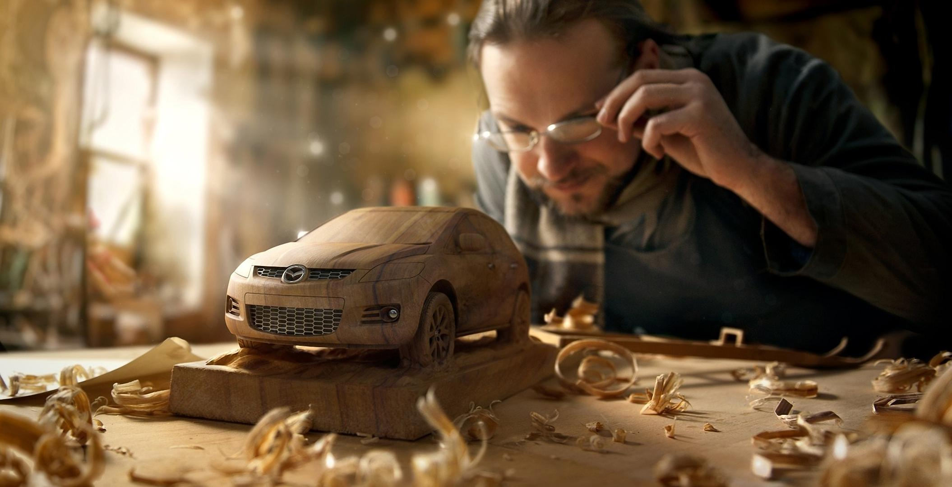
Milestone service center
ADMIN
FRONT OFFICE
WORKERS

Slide 3
FRONT OFFICE
User name
Password
BACK
LOG IN

Slide 4
ADMIN
User name
Password
BACK
LOG IN

Slide 5
WORKERS
User name
Password
BACK
LOG IN

Slide 6

customer history
Staff department
VEHICLE history
Sale
Work status
gallery
feedback
Pending works
Free service
Paid service
Repair
Performance tuning
LIST
LIST
LIST
LIST
LOG OUT

Slide 7
NEW
OPEN
SAVE
DELETE
RELOAD
PRINT
CLOSE
LIST
WORK STATUS
Free service
Paid service
Repair
Performance tuning
Customer details
New customer
KMs/time: 12000
Service Count: 5
Name: customer1
Address: place
Contact no.: 123
License number: 321
Suggestions
No.
01
Clutch problem
Vehicle details
New vehicle
Number plate: KL 46 R 258
Make: RE
Model: Classic 350
Year: 2017
Color: black
Fuel type: P
Gear type: M
Engine no: 43323
Warranty expiry: 2019
Insurance details:
No.
payment services/part description
Time
Amount
01
Oil change
2hrs
DISCOUNTS:
TOTAL:

Slide 8
NEW
OPEN
SAVE
DELETE
RELOAD
PRINT
CLOSE
LIST
WORK STATUS
Free service
Paid service
Repair
Performance tuning
Customer details
New customer
KMs/time: 12000
Service Count: 5
Name: customer1
Address: place
Contact no.: 123
License number: 321
Suggestions
No.
01
Clutch problem
Vehicle details
New vehicle
Number plate: KL 46 R 258
Make: RE
Model: Classic 350
Year: 2017
Color: black
Fuel type: P
Gear type: M
Engine no: 43323
Warranty expiry: 2019
Insurance details:
No.
payment services/part description
Time
Amount
01
Oil change
DISCOUNTS:
TOTAL:

Slide 9
NEW
OPEN
SAVE
DELETE
RELOAD
PRINT
CLOSE
LIST
WORK STATUS
Free service
Paid service
Repair
Performance tuning
Customer details
New customer
No.
Suggestions
Name: customer2
Address: place
Mobile number: 2323
License number: 3423
1
Over heating
New vehicle
Vehicle details
Number plate: KL46-2367
Make: Suzuki
Model: wagon R
Year: 2012
Color: white
Fuel type: P
Gear type: M
Engine no:
Warranty expiry:
Insurance details:
KMs:
No.
payment services/part description
Time
Amount
DISCOUNTS:
TOTAL:

Slide 10
NEW
OPEN
SAVE
DELETE
RELOAD
PRINT
CLOSE
LIST
WORK STATUS
Free service
Paid service
Repair
Performance tuning
Customer details
New customer
No.
Suggestions
Name:
Address:
Mobile number:
License number:
Vehicle details
New vehicle
Number plate:
Make:
Model:
Year:
Color:
Fuel type:
Gear type:
Engine no:
Warranty expiry:
Insurance details:
KMs:
No.
payment services/part description
Time
Amount
DISCOUNTS:
TOTAL:

Slide 11
FREE SERVICE
No. | Customer name | Contact No. | Vehicle | Number plate | suggestions | Part description | Time | priority | status
1 | customer1 | 9995605574 | Classic 350 | KL 46 R 258 | Clutch problem | Oil change | 2hrs | 100 | working
2 | Customer2 | 9946666015 | Mustang | KL 46 R 505 |  | Oil change | 4hrs | 200 | waiting
BACK
MAIN MENU

Slide 12
paid SERVICE
No. | Customer name | Contact No. | Vehicle | Number plate | suggestions | Part description | Time | priority | status
1 | customer1 | 9995605574 | Classic 350 | KL 46 R 258 | Clutch problem | Oil change | 2hrs | 100 | working
2 | Customer2 | 9946666015 | Mustang | KL 46 R 505 |  | Oil change | 4hrs | 200 | waiting
BACK
MAIN MENU

Slide 13
Repair SERVICE
No. | Customer name | Contact No. | Vehicle | Number plate | suggestions | Part description | Time | priority | status
1 | customer1 | 9995605574 | Classic 350 | KL 46 R 258 | Clutch problem | Oil change | 2hrs | 100 | working
2 | Customer2 | 9946666015 | Mustang | KL 46 R 505 |  | Oil change | 4hrs | 200 | waiting
BACK
MAIN MENU

Slide 14
performance tuning
No. | Customer name | Contact No. | Vehicle | Number plate | suggestions | Part description | Time | priority | status
1 | customer1 | 9995605574 | Classic 350 | KL 46 R 258 | Clutch problem | Oil change | 2hrs | 100 | working
2 | Customer2 | 9946666015 | Mustang | KL 46 R 505 |  | Oil change | 4hrs | 200 | waiting
BACK
MAIN MENU

Slide 15
ASSIGN WORKER
WASHING | PAINTING | TYRE & ALIGNMENT | BODY REPAIR | ENGINE REPAIR
WORKER1 | WORKER1 | WORKER1 | WORKER1 | WORKER1
WORKER2 | WORKER2 | WORKER2 | WORKER2 | WORKER2
WORKER3 | WORKER3 | WORKER3 | WORKER3 | WORKER3
WORKER4 | WORKER4 | WORKER4 | WORKER4 | WORKER4
(0 w)
(0 w)
(0 w)
(0 w)
(0 w)
(0 h)
(0 h)
(0 h)
(0 h)
(0 h)
(0 w)
(0 w)
(0 w)
(0 w)
(0 w)
(0 h)
(0 h)
(0 h)
(0 h)
(0 h)
(0 w)
(0 w)
(0 w)
(0 w)
(0 w)
(0 h)
(0 h)
(0 h)
(0 h)
(0 h)
(0 w)
(0 w)
(0 w)
(0 w)
(0 w)
(0 h)
(0 h)
(0 h)
(0 h)
(0 h)
OK

Slide 16
ASSIGN WORKER
WASHING | PAINTING | TYRE & ALIGNMENT | BODY REPAIR | ENGINE REPAIR
WORKER1 | WORKER1 | WORKER1 | WORKER1 | WORKER1
WORKER2 | WORKER2 | WORKER2 | WORKER2 | WORKER2
WORKER3 | WORKER3 | WORKER3 | WORKER3 | WORKER3
WORKER4 | WORKER4 | WORKER4 | WORKER4 | WORKER4
(0 w)
(0 w)
(0 w)
(0 w)
(0 w)
(0 h)
(0 h)
(0 h)
(0 h)
(0 h)
(0 w)
(0 w)
(0 w)
(0 w)
(0 w)
(0 h)
(0 h)
(0 h)
(0 h)
(0 h)
(0 w)
(0 w)
(0 w)
(0 w)
(0 w)
(0 h)
(0 h)
(0 h)
(0 h)
(0 h)
(0 w)
(0 w)
(0 w)
(0 w)
(0 w)
(0 h)
(0 h)
(0 h)
(0 h)
(0 h)
OK

Slide 17
ASSIGN WORKER
WASHING | PAINTING | TYRE & ALIGNMENT | BODY REPAIR | ENGINE REPAIR
WORKER1 | WORKER1 | WORKER1 | WORKER1 | WORKER1
WORKER2 | WORKER2 | WORKER2 | WORKER2 | WORKER2
WORKER3 | WORKER3 | WORKER3 | WORKER3 | WORKER3
WORKER4 | WORKER4 | WORKER4 | WORKER4 | WORKER4
(0 w)
(0 w)
(0 w)
(0 w)
(0 w)
(0 h)
(0 h)
(0 h)
(0 h)
(0 h)
(0 w)
(0 w)
(0 w)
(0 w)
(0 w)
(0 h)
(0 h)
(0 h)
(0 h)
(0 h)
(0 w)
(0 w)
(0 w)
(0 w)
(0 w)
(0 h)
(0 h)
(0 h)
(0 h)
(0 h)
(0 w)
(0 w)
(0 w)
(0 w)
(0 w)
(0 h)
(0 h)
(0 h)
(0 h)
(0 h)
OK

Slide 18
ASSIGN WORKER
WASHING | PAINTING | TYRE & ALIGNMENT | BODY REPAIR | ENGINE REPAIR
WORKER1 | WORKER1 | WORKER1 | WORKER1 | WORKER1
WORKER2 | WORKER2 | WORKER2 | WORKER2 | WORKER2
WORKER3 | WORKER3 | WORKER3 | WORKER3 | WORKER3
WORKER4 | WORKER4 | WORKER4 | WORKER4 | WORKER4
(0 w)
(0 w)
(0 w)
(0 w)
(0 w)
(0 h)
(0 h)
(0 h)
(0 h)
(0 h)
(0 w)
(0 w)
(0 w)
(0 w)
(0 w)
(0 h)
(0 h)
(0 h)
(0 h)
(0 h)
(0 w)
(0 w)
(0 w)
(0 w)
(0 w)
(0 h)
(0 h)
(0 h)
(0 h)
(0 h)
(0 w)
(0 w)
(0 w)
(0 w)
(0 w)
(0 h)
(0 h)
(0 h)
(0 h)
(0 h)
OK

Slide 19
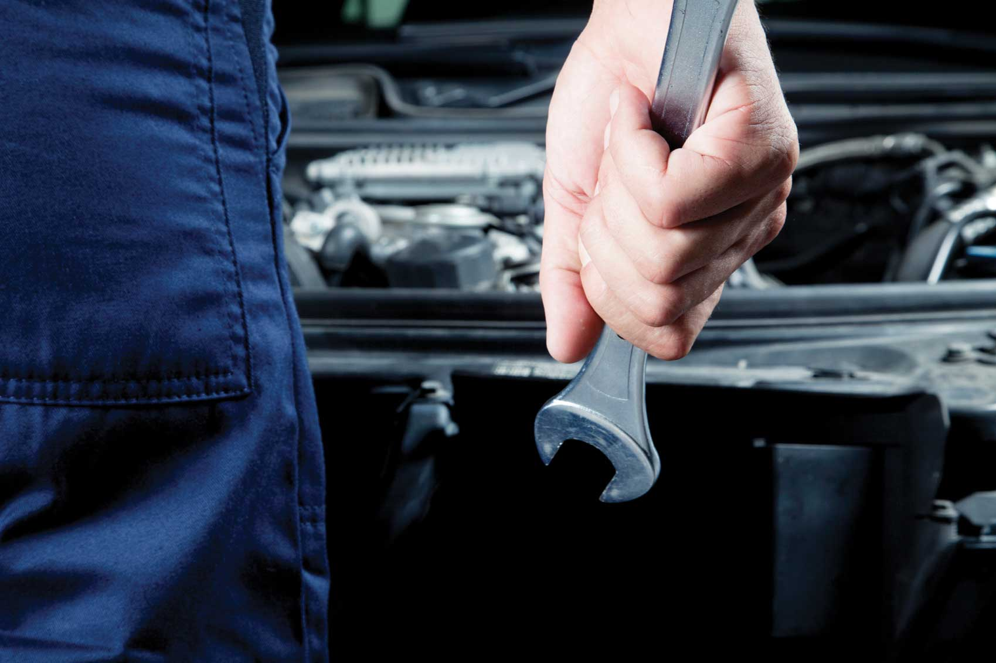
MILESTONE SERVICE CENTER
MESSAGES
NEW TASKS
STOCK DETAILS
PENDING TASKS
MONTHLY REPORT
WORK HISTORY
LEAVE ENTRY
LOG OUT

Slide 20
TASKS
CUSTOMER NAME | CONTACT NO. | NUMBER PLATE | YEAR | SUGGESTIONS | PART DESCRIPTION | PRIORITY | MORE
CUSTOMER1 | 9995605574 | KL46 R 258 | 2017 | clutch problem | oil change | 100 |  | START
 |  |  |  |  |  |  |  | START
 |  |  |  |  |  |  |  | START
 |  |  |  |  |  |  |  | START
 |  |  |  |  |  |  |  | START
 |  |  |  |  |  |  |  | START
 |  |  |  |  |  |  |  | START
 |  |  |  |  |  |  |  | START
 |  |  |  |  |  |  |  | START
BACK

Slide 21
PENDINg TASKS
CUSTOMER NAME | CONTACT NO. | NUMBER PLATE | YEAR | SUGGESTIONS | PART DESCRIPTION | PRIORITY | MORE
CUSTOMER1 | 9995605574 | KL46 R 258 | 2017 | clutch problem | oil change | 100 |  | START
 |  |  |  |  |  |  |  | START
 |  |  |  |  |  |  |  | START
 |  |  |  |  |  |  |  | START
 |  |  |  |  |  |  |  | START
 |  |  |  |  |  |  |  | START
 |  |  |  |  |  |  |  | START
 |  |  |  |  |  |  |  | START
 |  |  |  |  |  |  |  | START
BACK

Slide 22
Number plate: | KL46 R 258
Make: | RE
Model: | Classic 350
Year: | 2017
Color: | Black
Fuel type: | P
Gear type: | M
Engine no: | 43323
Warranty expiry: | 2019
Insurance details:
KMs: | 12000
Service count: | 5
OK

Slide 23
RE Classic 350
Time:
2hrs
Close task
Hold task
Report
Add time
No | suggestions
 | clutch problem
No | payment services/part description | Amount
 | oil change
Customer number
9995605574
Stock purchase
BACK

Slide 24
RE Classic 350
Time:
2hrs
Close task
Hold task
Report
Add time
2hrs
No | suggestions
 | clutch problem
No | payment services/part description | Amount
 | oil change
Change clutch disk
Add reason
Customer number
9995605574
Stock purchase
BACK

Slide 25
CUSTOMER DETAILS
NAME | ADDRESS | CONTACT NO. | LICENSE NO. | EMAIL | VEHICLES
CUSTOMER1 | ABCD | 123 | 231
MAIN MENU

Slide 26
VEHICLE DETAILS
Number plate | Make | Model | Year | Color | Fuel type | Gear type | Engine no. | Warranty details | Insurance details | KMs | Time | Service count | customer
KL46 R 258 | RE | Classic 350 | 2017 | black | P | M | 43323 | 2019 |  | 12000 |  | 5
KL46 G 2367 | Suzuki | Wagon R | 2013 | White | P | M | 23345 |  |  | 65000
MAIN MENU

Slide 27
Number plate | Make | Model | Year | Color | Fuel type | Gear type | Engine no. | Warranty details | KMs | Time | Service count
KL46 R 258 | RE | Classic 350 | 2017 | black | P | M | 43323 | 2019 | 12000 |  | 5
KL46 G 2367 | Suzuki | Wagon R | 2013 | White | P | M | 23345 |  | 65000
BACK

Slide 28
NAME | ADDRESS | CONTACT NO. | LICENSE NO. | EMAIL
CUSTOMER1 | ABCD | 123 | 231
BACK

Slide 29
STAFF DEPARTMENT
WASHING
PAINTING
TYRE AND ALIGNMENT
BODY REPAIR
ENGINE REPAIR
OFFICE
MAIN MENU

Slide 30
WASHING STAFF
BACK
NAME | CONTACT NO. | STATUS
WORKER1 | 9946666499 | PRESENT
WORKER2
WORKER3

Slide 31
PAINTING STAFF
BACK
NAME | CONTACT NO. | STATUS
WORKER1 | 9946666499 | PRESENT
WORKER2
WORKER3

Slide 32
TYRE AND ALIGNMENT STAFF
BACK
NAME | CONTACT NO. | STATUS
WORKER1 | 9946666499 | PRESENT
WORKER2
WORKER3

Slide 33
BODY REPAIRING STAFF
BACK
NAME | CONTACT NO. | STATUS
WORKER1 | 9946666499 | PRESENT
WORKER2
WORKER3

Slide 34
ENGINE REPAIRING STAFF
BACK
NAME | CONTACT NO. | STATUS
WORKER1 | 9946666499 | PRESENT
WORKER2
WORKER3

Slide 35





search
MAIN MENU

Slide 36
search
MAIN MENU

Slide 37
search
Back to Task

Slide 38
SEARCH
ITEM NAME | STOCK | PRICE
CASTROL | 15 | 500
MOBIL1 | 20 | 450
VALVOLINE | 25 | 550
BACK

Slide 39
SEARCH
ITEM NAME | STOCK | PRICE
CASTROL | 15 | 500
MOBIL1 | 20 | 450
VALVOLINE | 25 | 550
ADD
ADD
ADD
ADD
BACK

Slide 40
WORK STATUS
SEARCH
NO | CUSTOMER NAME | Vehicle name | Contact no. | NUMBER PLATE | TYPE | Status | Time remaining | Reason for Additional time | more
010 | CUSTOMER1 | RE 350 | 9995605574 | KL46-R 258 | Free service | working | 2:45hrs | Change clutch disk
010 | CUSTOMER2 | Mustang | 9946666015 | KL 46-R 505 | Free service | Waiting | 3.30hrs | -
bill
bill
MAIN MENU

Slide 41
Status details
Worker | Work | Status | Time remaining
Worker1 | Oil change | Working | 15mins
 | Change clutch disk | Waiting | 2hrs
worker2 | wash | waiting | 30mins
BACK

Slide 42
customer DETAILS
Staff department
VEHICLE DETAILS
STOCK DETAILS
Work status
TASK TIME
ADD MEMO
LOG OUT

Slide 43
CUSTOMER DETAILS
NAME | ADDRESS | CONTACT NO. | LICENSE NO. | EMAIL | VEHICLES
CUSTOMER1 | ABCD | 123 | 231
MAIN MENU

Slide 44
Number plate | Make | Model | Year | Color | Fuel type | Gear type | Engine no. | Warranty details | KMs | Time | Service count
KL46 R 258 | RE | Classic 350 | 2017 | black | P | M | 43323 | 2019 | 12000 |  | 5
KL46 G 2367 | Suzuki | Wagon R | 2013 | White | P | M | 23345 |  | 65000
BACK

Slide 45
VEHICLE DETAILS
Number plate | Make | Model | Year | Color | Fuel type | Gear type | Engine no. | Warranty details | Insurance details | KMs | Time | Service count | customer
KL46 R 258 | RE | Classic 350 | 2017 | black | P | M | 43323 | 2019 |  | 12000 |  | 5
KL46 G 2367 | Suzuki | Wagon R | 2013 | White | P | M | 23345 |  |  | 65000
MAIN MENU

Slide 46
NAME | ADDRESS | CONTACT NO. | LICENSE NO. | EMAIL
CUSTOMER1 | ABCD | 123 | 231
BACK

Slide 47
STAFF DEPARTMENT
ADD STAFF
WASHING
PAINTING
TYRE AND ALIGNMENT
BODY REPAIR
ENGINE REPAIR
OFFICE
MAIN MENU

Slide 48
WASHING STAFF
BACK
NAME | CONTACT NO. | STATUS
WORKER1 | 9946666499 | PRESENT
WORKER2
WORKER3

Slide 49
PAINTING STAFF
BACK
NAME | CONTACT NO. | STATUS
WORKER1 | 9946666499 | PRESENT
WORKER2
WORKER3

Slide 50
TYRE AND ALIGNMENT STAFF
BACK
NAME | CONTACT NO. | STATUS
WORKER1 | 9946666499 | PRESENT
WORKER2
WORKER3

Slide 51
BODY REPAIRING STAFF
BACK
NAME | CONTACT NO. | STATUS
WORKER1 | 9946666499 | PRESENT
WORKER2
WORKER3

Slide 52
ENGINE REPAIRING STAFF
BACK
NAME | CONTACT NO. | STATUS
WORKER1 | 9946666499 | PRESENT
WORKER2
WORKER3

Slide 53
search
MAIN MENU

Slide 54
WORK STATUS
NO | CUSTOMER NAME | vehicle name | Contact no. | NUMBER PLATE | TYPE | Status | Time remaining | Reason for Additional time | more
010 | CUSTOMER1 | RE 350 | 9995605574 | KL46-R 258 | Free service | working | 2:45hrs | Change clutch disk
010 | CUSTOMER2 | Mustang | 9946666015 | KL 46-R 505 | Free service | Waiting | 3.30hrs | -
MAIN MENU

Slide 55
Status details
Worker | Work | Status | Time remaining
Worker1 | Oil change | Working | 15mins
 | Change clutch disk | Waiting | 2hrs
worker2 | wash | waiting | 30mins
BACK

Slide 56
SEARCH
ITEM NAME | STOCK | PRICE
CASTROL | 15 | 500
MOBIL1 | 20 | 450
VALVOLINE | 25 | 550
BACK

Slide 57
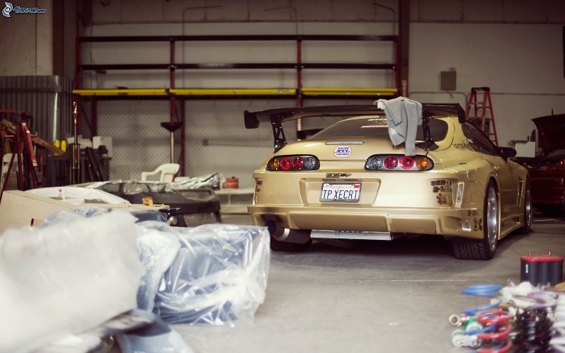
BACK

Slide 58
Task completion time
TASKS | TIME
Washing | 30 mins
Oil change | 15 mins
Full painting | 2 days
back

Slide 59
feedback
Customer name | Car name | Number plate | Phone number | E-mail id | Feedback | suggestion
Customer1 | mustang | KL46-R505 | 9946666015 | cust1@gmail.com | Good
Customer2 | RE 350 | KL46-R258 | 9995605574 | cust2@gmail.com | Average
BACK

Slide 60
Washing |  | Painting |  | TYRE & Alignment |  | Body repair |  | Engine repair
worker1 | Works: 1 | worker1 | Works: 1 | worker1 | Works: 1 | worker1 | Works: 1 | worker1 | Works: 1
 | Time: 15mins |  | Time: 15mins |  | Time: 15mins |  | Time: 15mins |  | Time: 15mins
worker2 | Works: 2 | worker2 | Works: 2 | worker2 | Works: 2 | worker2 | Works: 2 | worker2 | Works: 2
 | Time: 30 mins |  | Time: 30 mins |  | Time: 30 mins |  | Time: 30 mins |  | Time: 30 mins
BACK

